Slide 1




Predictive Maintenance for Industrial Equipment Using IoT Data.
Sameer Shinde

Slide 2

Overview
Problem Statement
Objectives & Benefits
Dataset Description
Architecture
Insights
ML Models for Predictive Maintenance
Dashboard View
Challenges and Future Work
Conclusion
03
04
05
06
07
08
10
12
13

Slide 3


Problem Statement
Industrial equipment failures lead to costly downtime and reduced productivity. Traditional maintenance approaches are either reactive, addressing breakdowns after they occur, or preventive, scheduled at fixed intervals, often leading to unnecessary servicing. Predictive maintenance, powered by IoT data and machine learning, offers a proactive solution by predicting failures before they happen, optimizing maintenance schedules, and minimizing downtime, thereby saving costs and improving equipment longevity. This system aims to leverage real-time sensor data and advanced models to ensure timely and accurate failure predictions for industrial equipment.

Slide 4
Objectives
Predict Failures : Leverage IoT and machine learning to forecast equipment breakdowns.
Optimize Maintenance : Enable data-driven, timely maintenance schedules.
Extend Equipment Life : Prevent failures, enhancing machinery longevity.
Support Decision-Making : Provide real-time insights for maintenance teams.
Advanced Modeling : Utilize Scikit-learn, XGBoost, LSTM, and ARIMA for precise predictions.
Benefits
Minimized Downtime: Avoid unexpected equipment failures.
Cost Efficiency: Reduce unnecessary maintenance and associated costs.
Operational Efficiency: Improve performance by maintaining equipment only when needed.
Real-Time Monitoring: Continuous health tracking with alerts and dashboards.
Scalability: Adaptable to various industrial environments and equipment types.

Slide 5
Dataset Description
The Predictive Maintenance project focuses on using IoT data to monitor industrial equipment performance and predict when maintenance is needed. The dataset includes information on temperature, vibration, pressure, RPM, and an indicator of maintenance requirements, along with calculated metrics such as changes in temperature and vibration over time.
Key Features of the Dataset:
Timestamp: Time of the sensor reading.
Temperature (°C): Temperature data in Celsius.
Vibration (mm/s): Vibration data in millimeters per second.
Pressure (Pa): Pressure data in Pascals.
RPM: Revolutions per minute.
Maintenance Required: A binary column indicating whether maintenance is required (1) or not (0).
Temp_Change: Change in temperature since the previous reading.
Vib_Change: Change in vibration since the previous reading.
Temperature_Mean: Average temperature recorded up to the current timestamp.
Vibration_Mean: Average vibration recorded up to the current timestamp.
Pressure_Mean: Average pressure recorded up to the current timestamp.
RPM_Mean: Average RPM recorded up to the current timestamp.

Slide 6
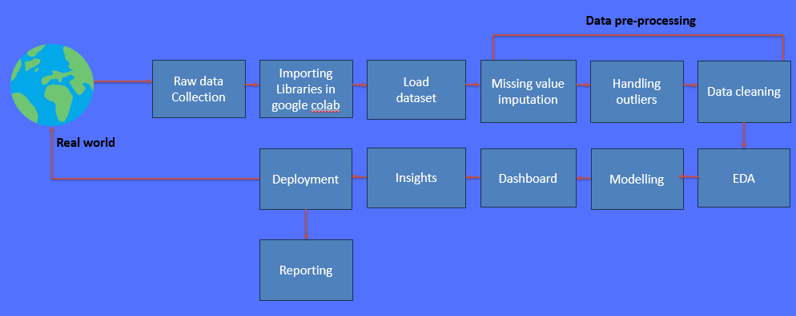
Architecture

Slide 7






Insights
Temperature Fluctuations: Notable spikes in temperature have been identified as strong indicators of increased maintenance requirements, suggesting a direct correlation between thermal stress and equipment performance.
Vibration Analysis: Abrupt changes in vibration patterns serve as critical precursors to potential equipment failures, highlighting the importance of continuous monitoring for predictive maintenance strategies.
Machine Learning Efficacy: Among the models tested, XGBoost and LSTM demonstrated superior predictive accuracy for forecasting maintenance needs. Their effectiveness in capturing complex data relationships enables the optimization of predictive maintenance strategies, leading to proactive interventions and enhanced operational efficiency.

Slide 8
ML Models for Predictive Maintenance
Scikit-learn Models:
Purpose : Used for baseline predictions and initial benchmarking.
Models Used :
Logistic Regression : Ideal for simple, binary classification tasks, such as whether or not maintenance is needed.
Random Forest : Handles more complex data, providing better accuracy by using an ensemble of decision trees.
Key Use Case : Initial testing phase for quick insights on equipment failure likelihood.
Strengths : Easy to interpret and fast to implement.
XGBoost
Purpose: Gradient-boosted decision trees capture complex interactions between multiple features.
Why XGBoost?: It handles missing data well, can detect nonlinear patterns, and is highly scalable, making it suitable for large IoT datasets.
Use Case: Prediction of failure based on combinations of temperature, vibration, and other variables.
Strengths: High accuracy, robust against overfitting, and fast execution due to parallel processing.

Slide 9
ML Models for Predictive Maintenance
LSTM (Long Short-Term Memory):
Purpose: A type of Recurrent Neural Network (RNN) designed for time-series forecasting.
Why LSTM?: It retains memory of long-term dependencies in the sensor data, making it effective for predicting failure trends over time.
Use Case: Forecasting future equipment health based on historical sensor data (e.g., predicting vibration patterns).
Strengths: Superior performance with sequential data and captures time-dependent behaviors.
ARIMA (AutoRegressive Integrated Moving Average):
Purpose: A traditional statistical model used for analyzing and forecasting time-series data.
Why ARIMA ?: Excellent for long-term trend analysis and understanding seasonality in equipment data.
Use Case: Analyzing trends in temperature, vibration, and pressure over months or years to predict future behavior.
Strengths: Strong for identifying trends and patterns over long time periods, and simple to implement.

Slide 10

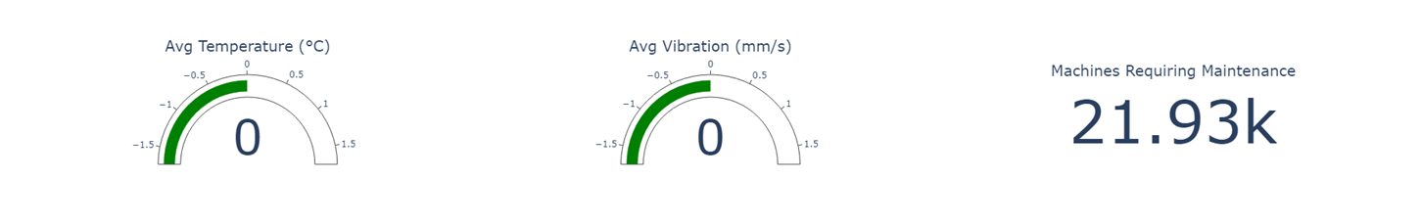
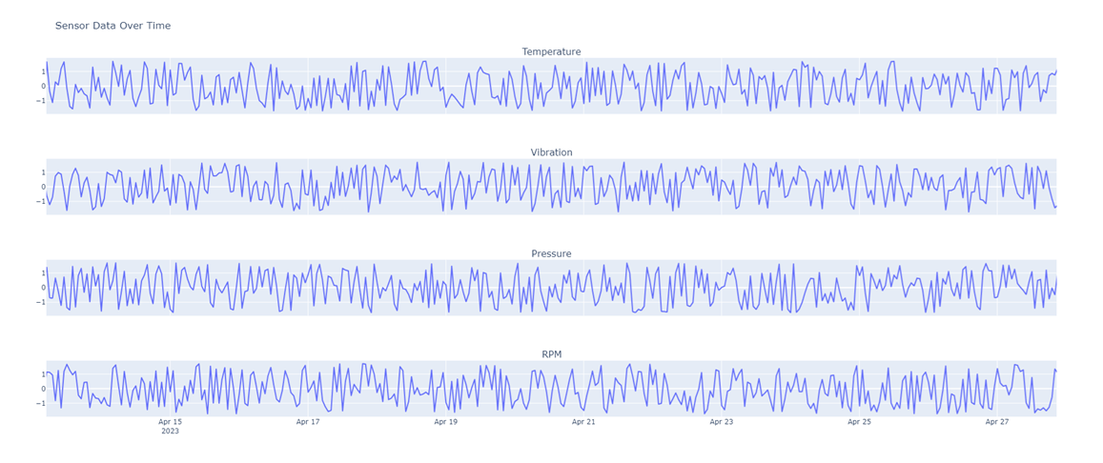

Dashboard View

Slide 11
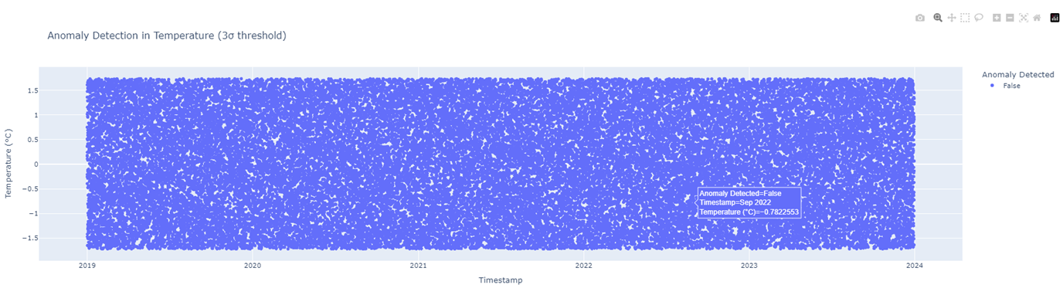
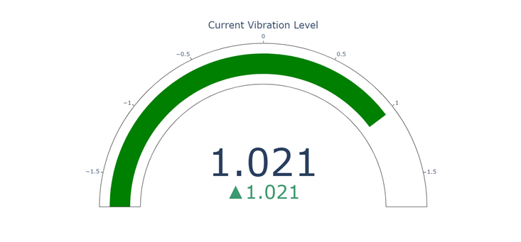
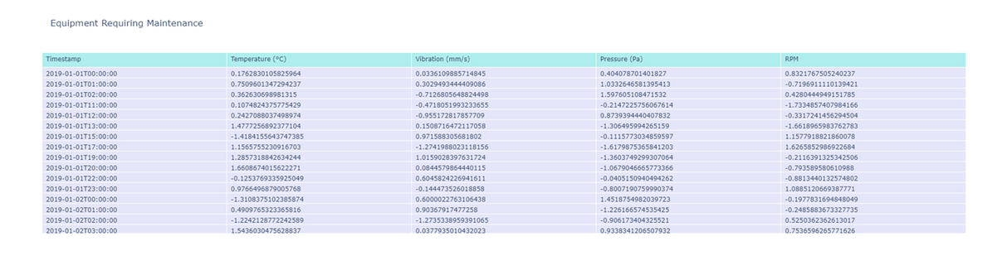

Slide 12


Challenges and Future Work
Data Quality and Sensor Accuracy: Ensuring high-quality, reliable data from sensors is critical for accurate predictions.
Integration with Existing Maintenance Systems: Seamlessly integrating predictive maintenance solutions with current maintenance workflows and systems presents significant hurdles.
Advanced Modeling Techniques: Explore the implementation of neural networks for enhanced real-time predictive analytics, allowing for more complex and accurate predictions.
Cloud Integration: Leverage cloud computing for large-scale data analysis, facilitating the processing and storage of vast amounts of IoT data to improve insights and decision-making.
Olivia Wilson

Slide 13
Conclusion
The Predictive Maintenance project successfully leveraged IoT data to predict equipment failures, detect anomalies, and optimize maintenance schedules.
Through comprehensive data preprocessing, feature engineering, and model selection, we were able to effectively predict critical equipment conditions that require intervention. The use of advanced machine learning algorithms, such as XGBoost and LSTM, enhanced the prediction accuracy, while anomaly detection using One-Class SVM and real-time monitoring via Power BI/Tableau allowed for proactive decision-making.
This project demonstrated the value of predictive maintenance in minimizing downtime, reducing unexpected failures, and optimizing operational costs.
By implementing this solution, industrial operations can transition from reactive to proactive maintenance strategies, ensuring improved equipment reliability and enhanced business performance.
Future work can explore integrating additional data sources and refining model performance for even greater accuracy and scalability.

Slide 14




THANK TOU
For watching this presentation
Sameer Shinde
+123-456-7890
sameershinde1621@gmail.com
https://github.com/Sameer8750/Vervebridge_Task

